Slide 1

Expertise Hub
- An expert locating system.

Slide 2
Introduction
Web based app
User Friendly
Concise, clear and engaging

Slide 3
Objective
Our objective is to provide a supportive and inclusive environment that fosters open communicate, encourages active listening, and values diverse perspectives.

Slide 4
Project Progress
System Analysis
System Design

Slide 5
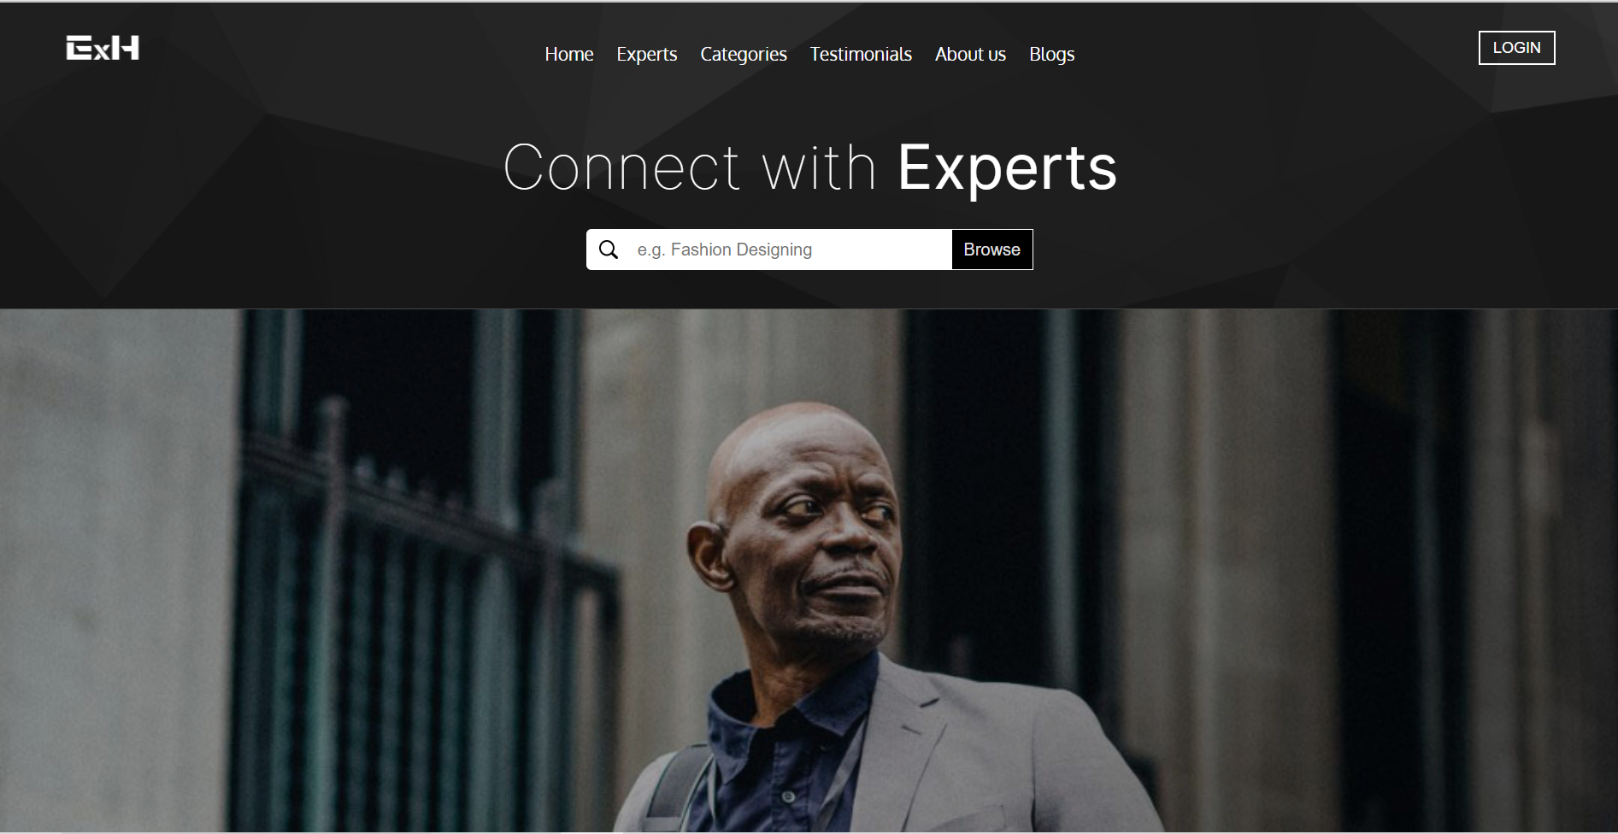
Landing Page

Slide 6
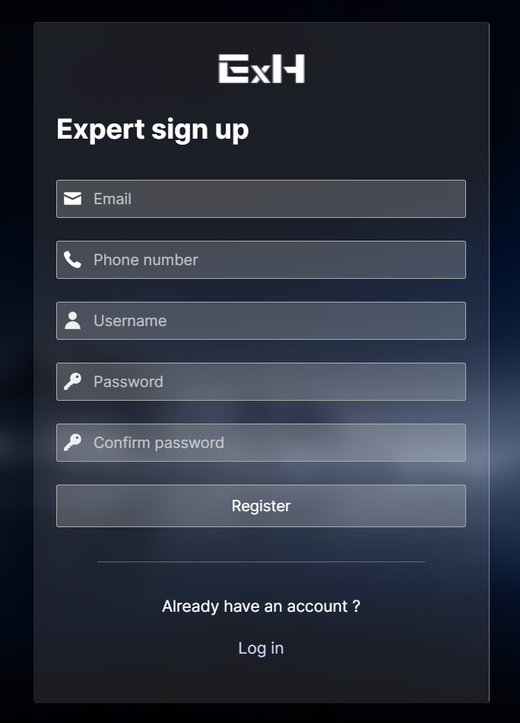
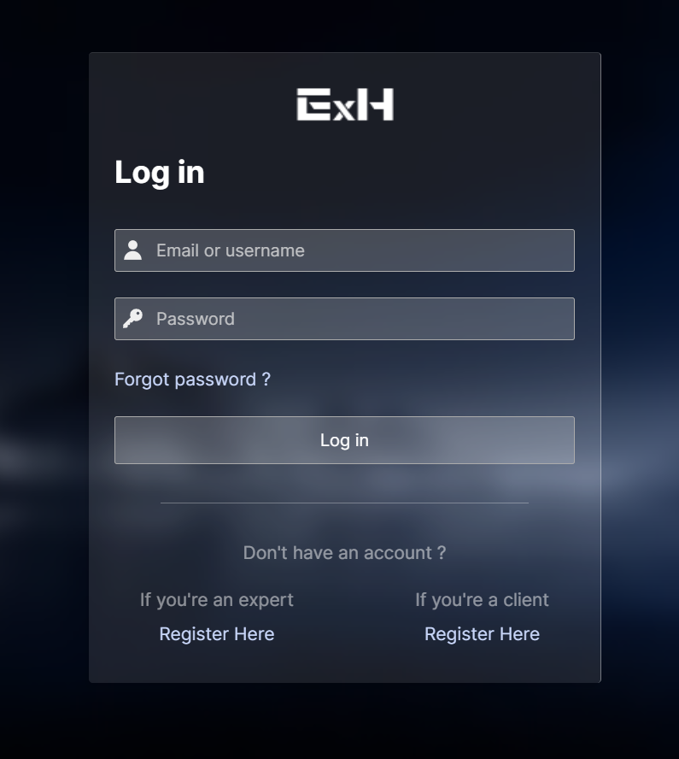
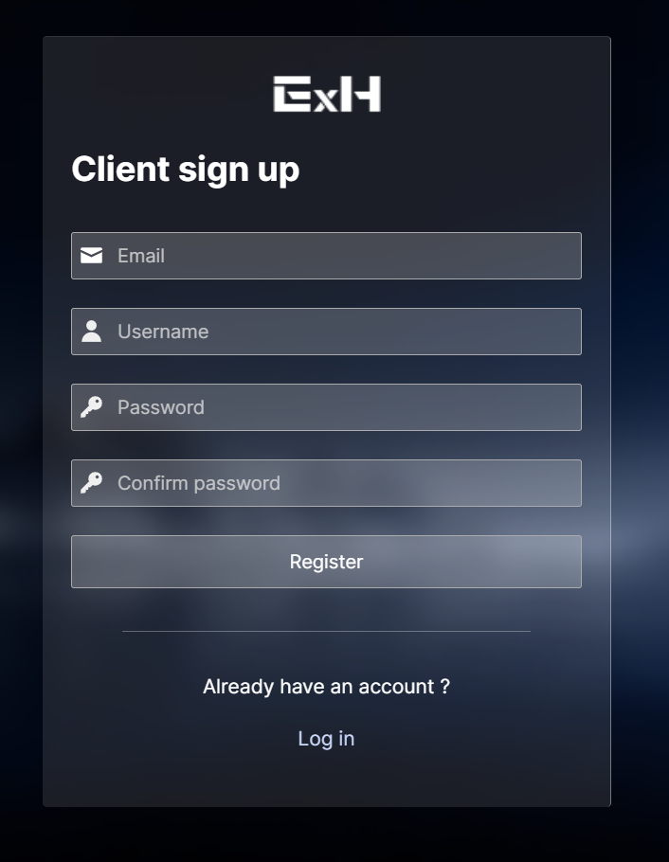
Log in / Sign up Forms

Slide 7
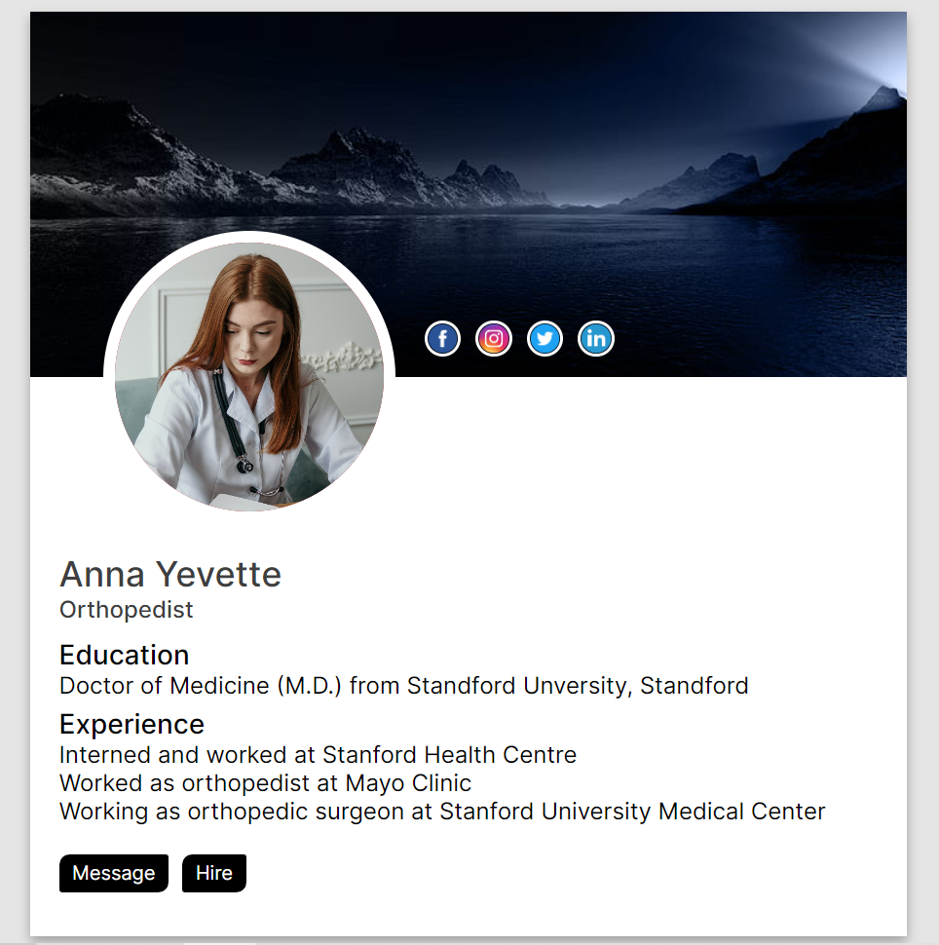
Profile Page

Slide 8
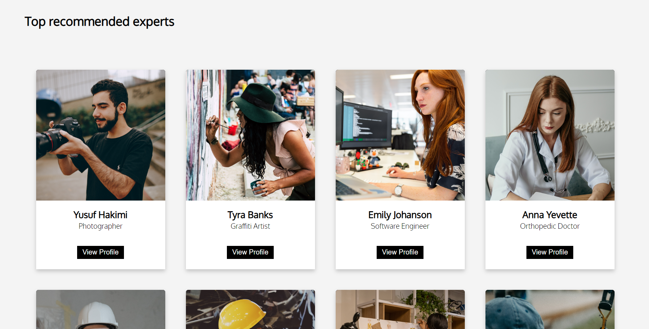
Expert List

Slide 9
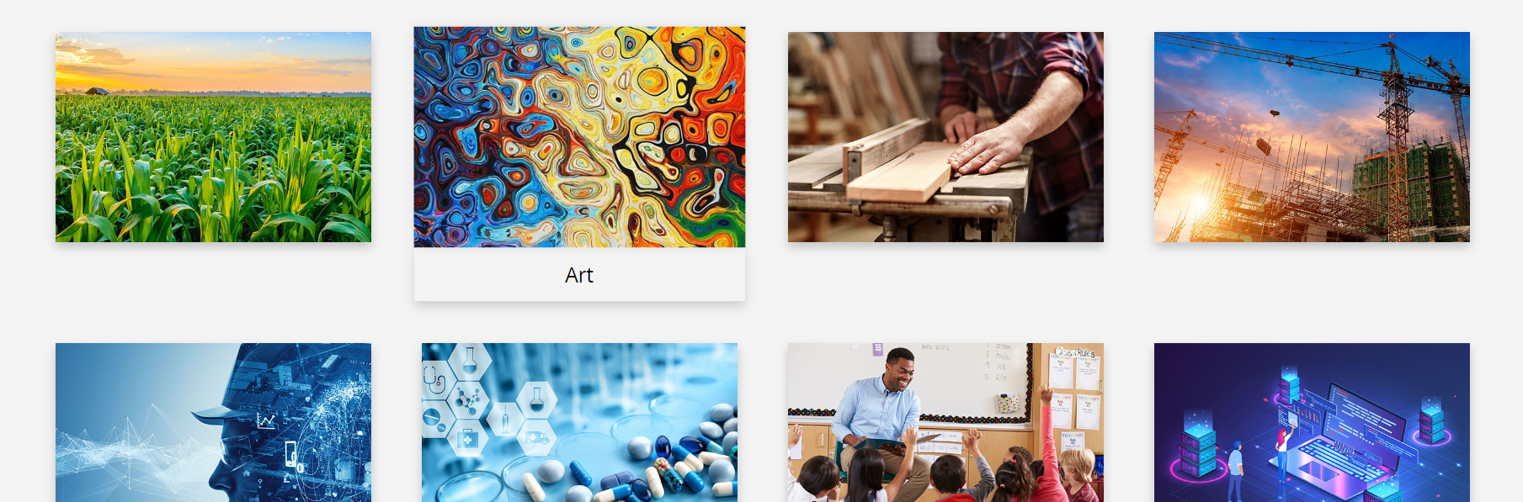
Category

Slide 10
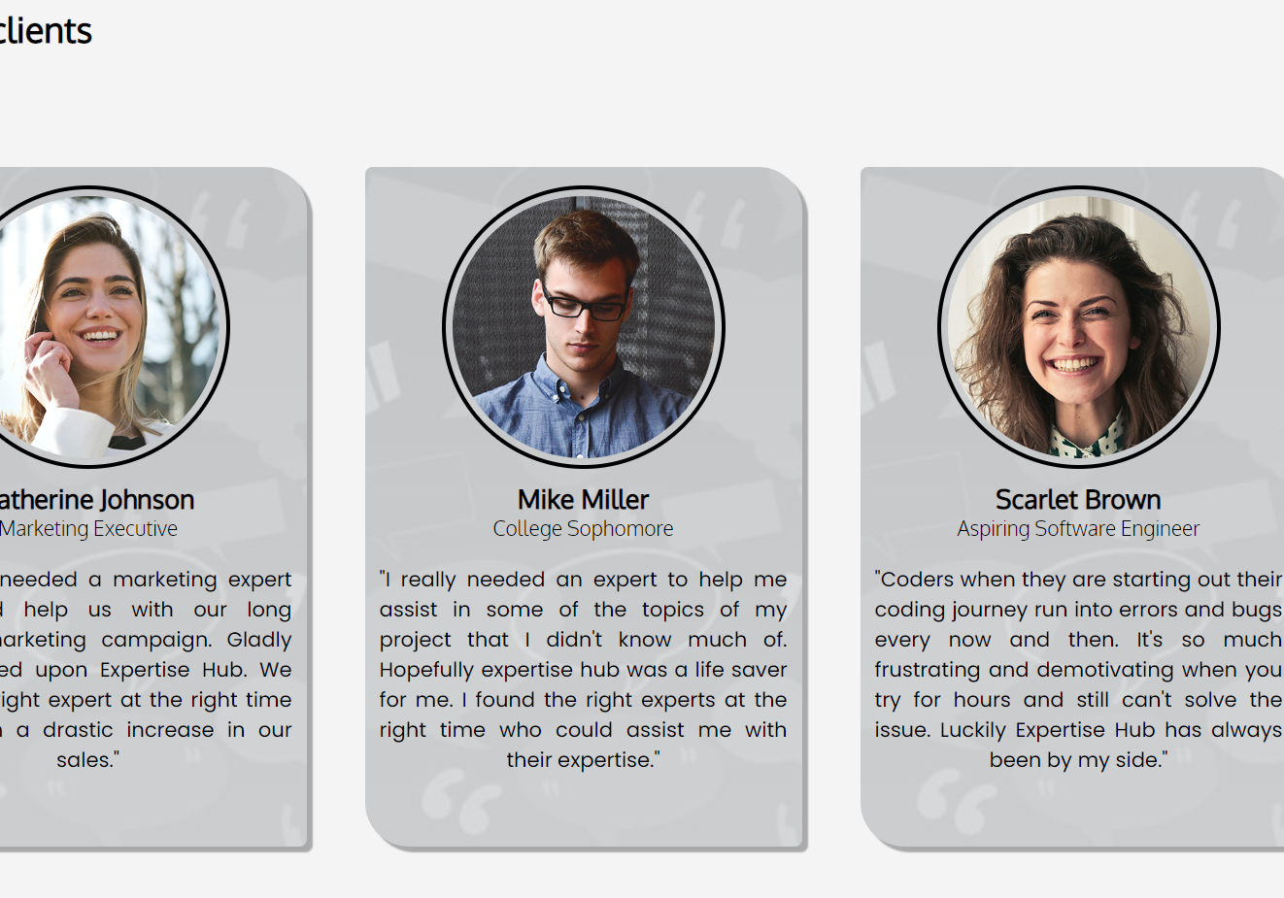
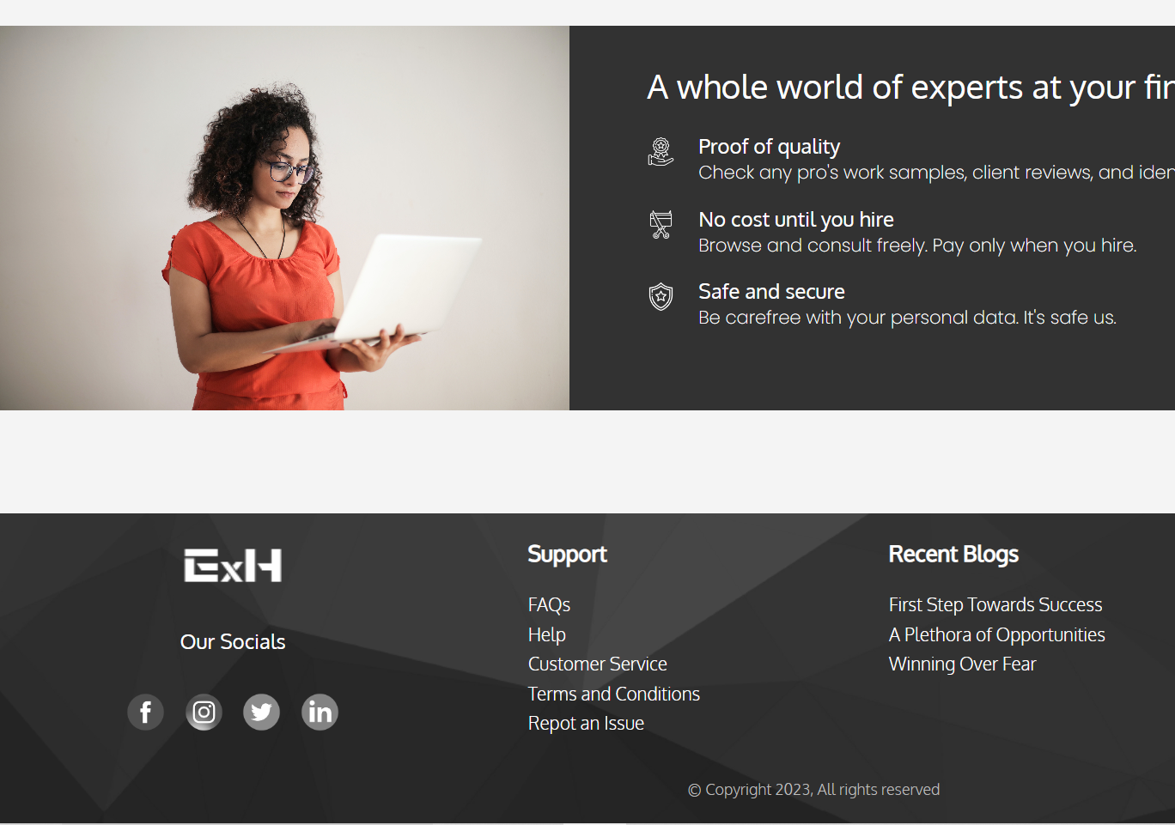
Testimonials and footer section

Slide 11
Remaining Sections
-Implementing and Testing
Backend Implementation

Slide 12
Thank You
Sujal Shrestha
Maheshwor Nagarkoti
Biplob Prasad Lamichane

